Slide 1
Human Development Module 3

Slide 2
Developmental psychology: branch of psychology ; scientific study of how people grow and change over the course of a lifetime
Originally concerned with infants and children; expanded to include adolescence, adult development, ageing and the entire life span
Examines change across a broad range of development including motor skills and psycho-physiological processes and cognitive development involving areas such as:
Problem solving
Moral understanding
Conceptual understanding
Language acquisition
Social development
Emotional development
Self-concept and identity formation
Personality development

Slide 3
Scope of application not limited to psychology but also sociology, education, history, anthropology, biology, healthcare and the like
Practical application of life span development: how and why people change and optimizing human potential
Important debates within developmental psychology:
Genetics vs environment: Nature vs Nurture Debate or BOTH
The process through which development occurs
Importance of early life experiences vs later life events
Continuity vs Discontinuity: does change occur smoothly over time or through a series of predetermined steps

Slide 4
Major theories of development:
Psychoanalytic theories
Learning theories
Cognitive theories
Psychoanalytic theories: influenced by the work of Sigmund Freud; emphasis on the unconscious mind and childhood experiences
Development occurs through a series of stage
Erik Erikson expanded on Freud’s ideas by proposing the 8 stage theory of psychosocial development; focus on conflicts that arise at different stages of development throughout the life span
Learning Theories: focus on how the environment impacts behavior; important learning processes include classical conditioning, operant conditioning and social learning
Cognitive theories: focus on the development of mental processes, skills and abilities such as Piaget’s theory of cognitive development

Slide 5
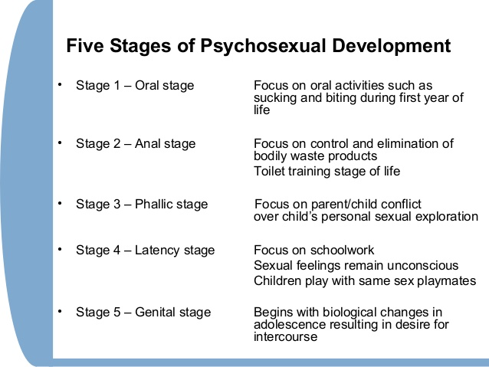
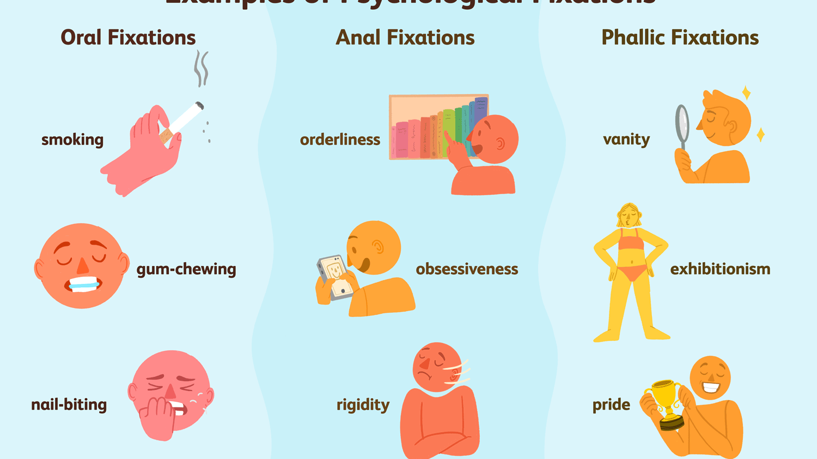
Freud’s Psychosexual stages of development:

Slide 6
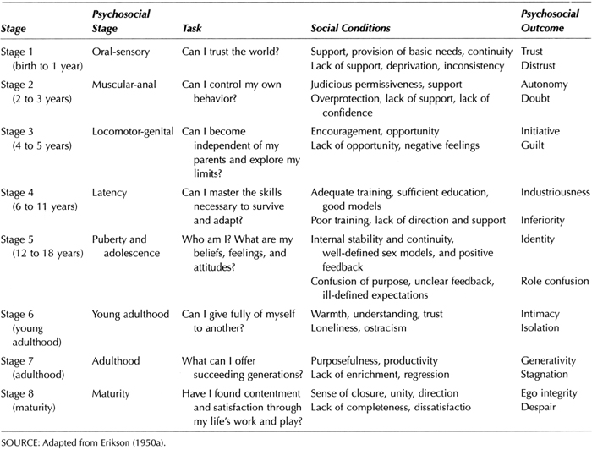
Erikson’s theory of psychosocial development

Slide 26
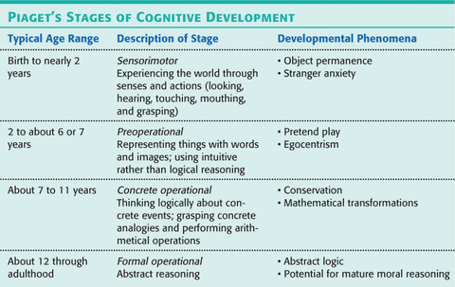

Slide 29
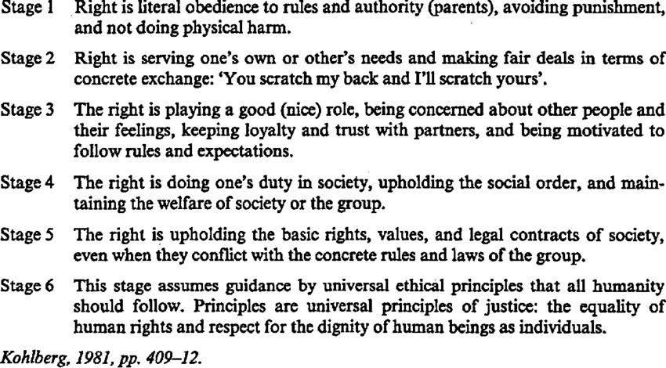
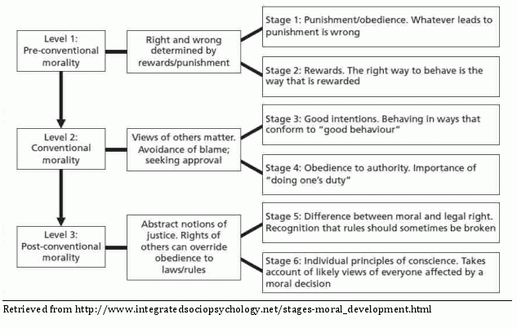

Slide 74
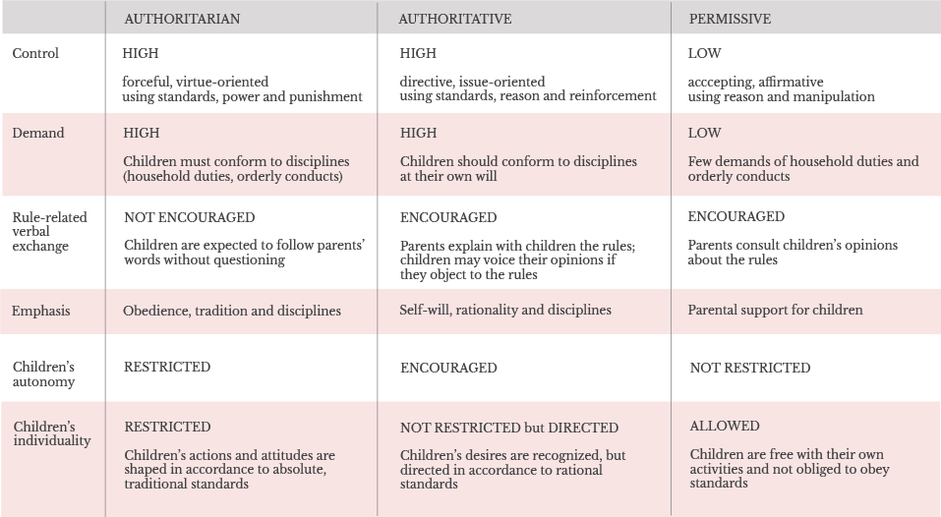
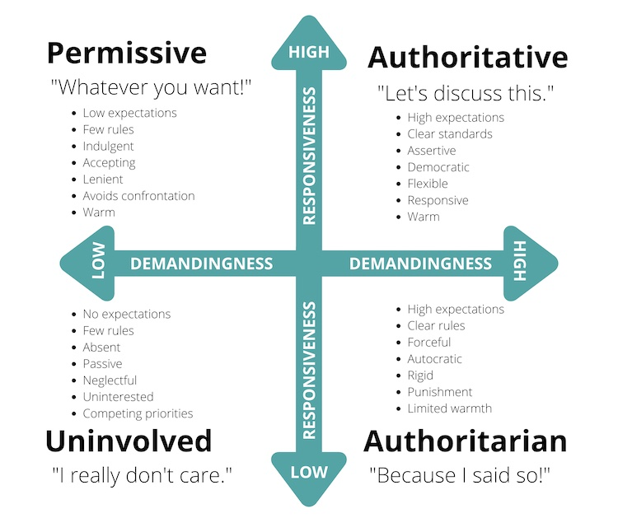

Slide 84
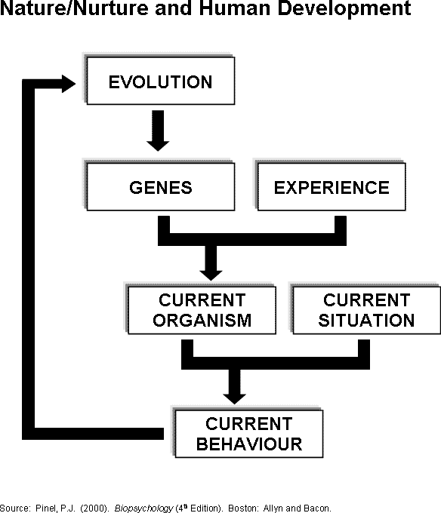

Slide 85
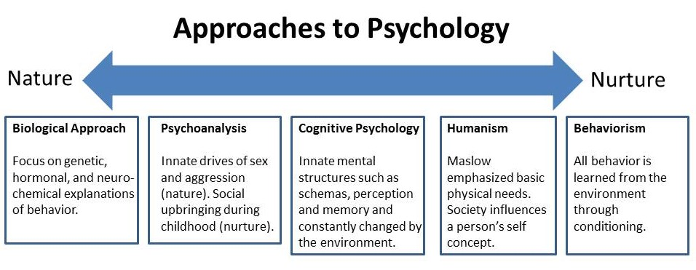

Slide 93
Developmental tasks
Adjustment issues during infancy: congenital conditions (autism, intellectual deficits, cerebral palsy), temperament, failure to thrive
Early childhood: new found mobility vs cognitive and language development, fears and phobias, elective mutism
Later childhood: school experience and scholastic skills and achievement, school phobia, learning difficulties, self-esteem,
Adolescence: developing expressions of sexuality, abuse, unplanned pregnancies and parenthood, status offences (truancy, drinking, running away from home), delinquency, substance abuse, mental health problems (eating disorders, depression), peer pressure
Young and middle adulthood: intimacy vs isolation, Levinson’s 4 tasks (fit into adult world, establish intimate relationship and enter parenthood, occupation, mentor)
Intimate partnerships and assertive mating (tendency for partners to resemble each other in physical characteristics, intelligence, education, social and ethnic backgrounds, religion, temperaments, life outlook), divorce
Parenthood and transition to the ‘empty nest’
Vocational development: work choice, work change, life satisfaction, unemployment
Midlife transition: appraisal of one’s life as lived, decision to stay the course or change
Midlife crisis

Slide 94
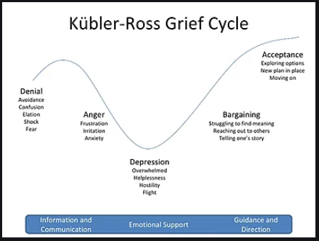
Developmental tasks
Old age: Integrity vs despair; wisdom, life review, retirement, grandparenthood; coping with loss (widows and widowers), facing mortality and death, brain disorders, financial concerns

